Slide 1
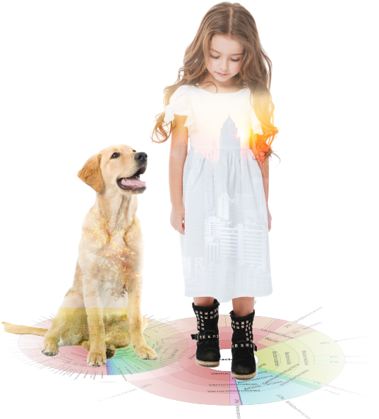
Improving the Accuracy and Reproducibility of Microbiome Measurements
Shuiquan Tang
stang@zymoresearch.com
Zymo Research Corp.
GSC2018, San Diego

Slide 2
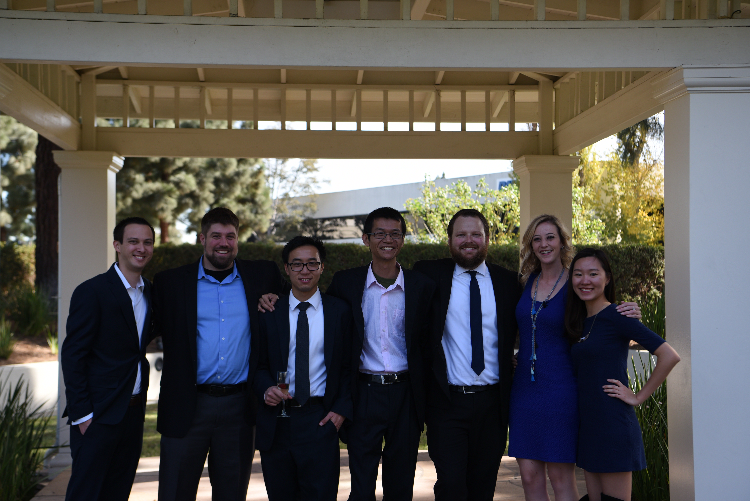
Acknowledgements
Dr. Larry Jia
Ryan Kemp
Dr. Marc Van Eden
Dr. Standa Forman
Eric Kircher
John Sherman
Luigi Basillio
Michelle Thai
Steven Wong
Mikayla Mager
Joshua Tjokrosurjo
Ryan Sasada
Emily Chen
The Microbiomics Team

Slide 3
Outline
Microbiomics, Macro-Bias
Microbiome Standards
What can they tell us?
What defines a reliable microbiome standard?
Pitfalls in Microbiome Profiling
Address Unsolved Challenges With New tools
Species-Level Resolution with Regular Illumina 16S Sequencing?

Slide 4
1. Microbiomics, Macro-Bias

Slide 5
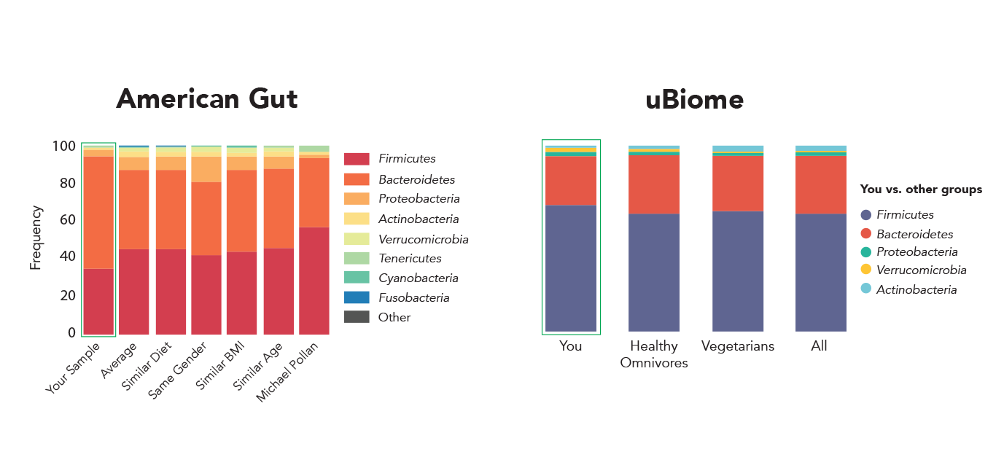
Example 1: Even leaders reported contradictory results!
The figure was adapted from:
"Here's the Poop on Getting Your Gut Microbiome Analyzed." Science News. 2014.

Slide 6
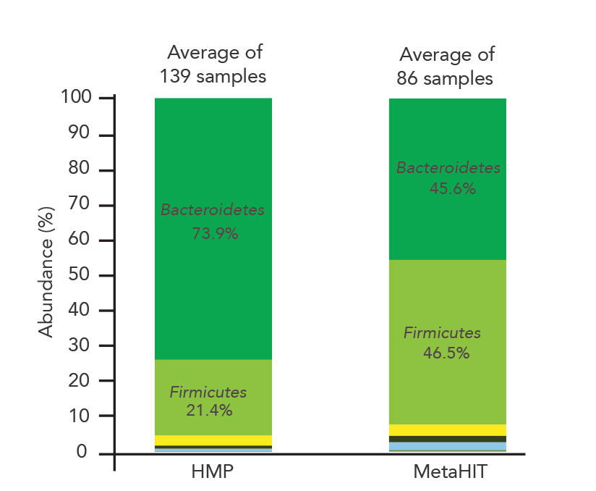
Example 2: HMP vs. MetaHIT in the Human Gut
Biological or Technical?
The analysis data were downloaded from the website of MetaPhlan2:
http://huttenhower.sph.harvard.edu/sites/default/files/gut.HMP+MH.healthy.txt

Slide 7
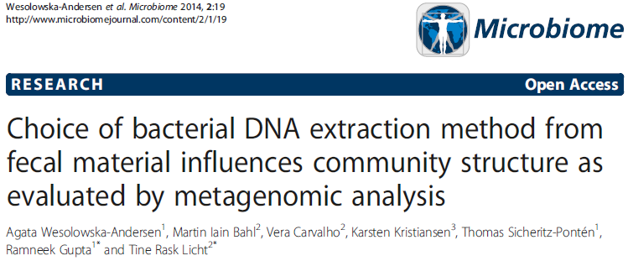
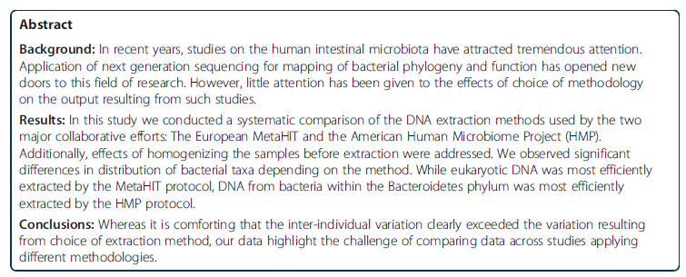

Slide 8
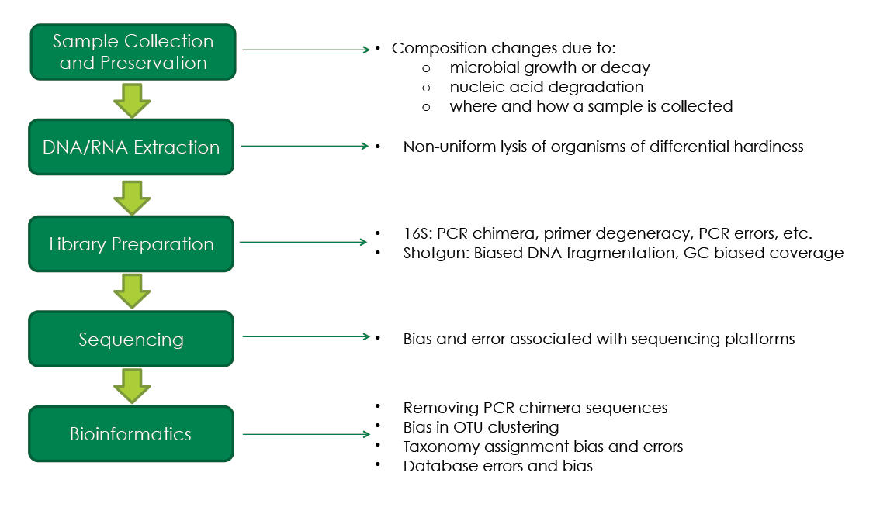
Challenges in Microbiome Measurements

Slide 9
“Microbiomics-Grade” Kits/Reagents
Free of
Contaminations
Unbiased

Slide 10
2. Microbiome Standards

Slide 11
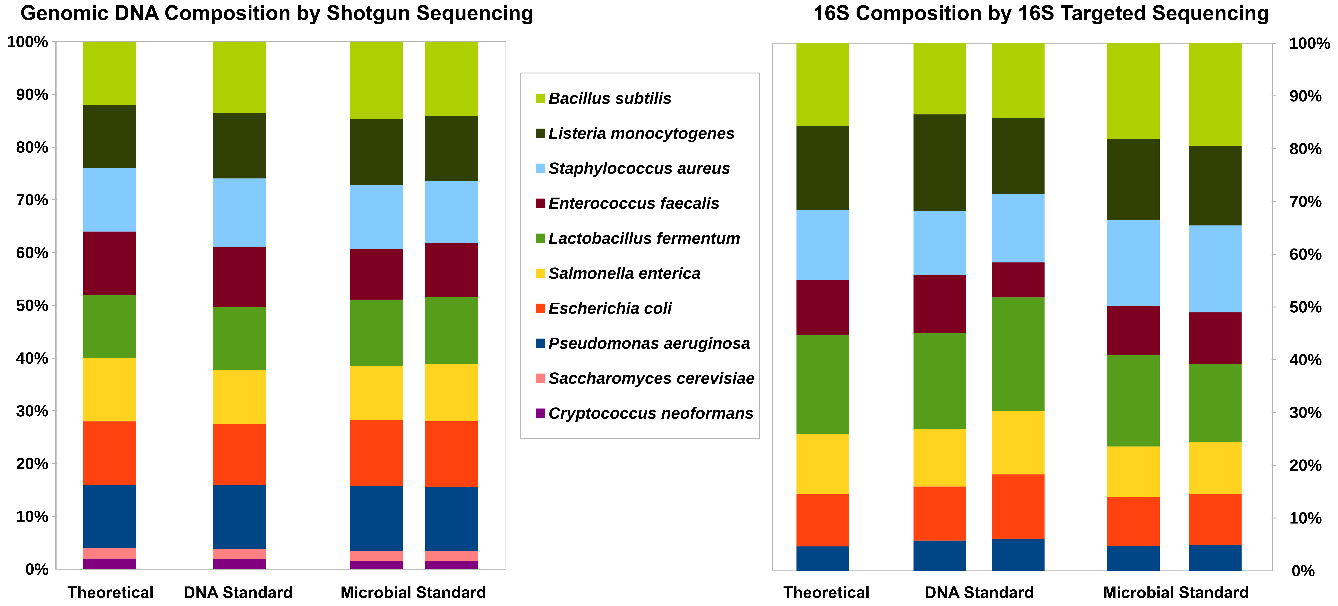
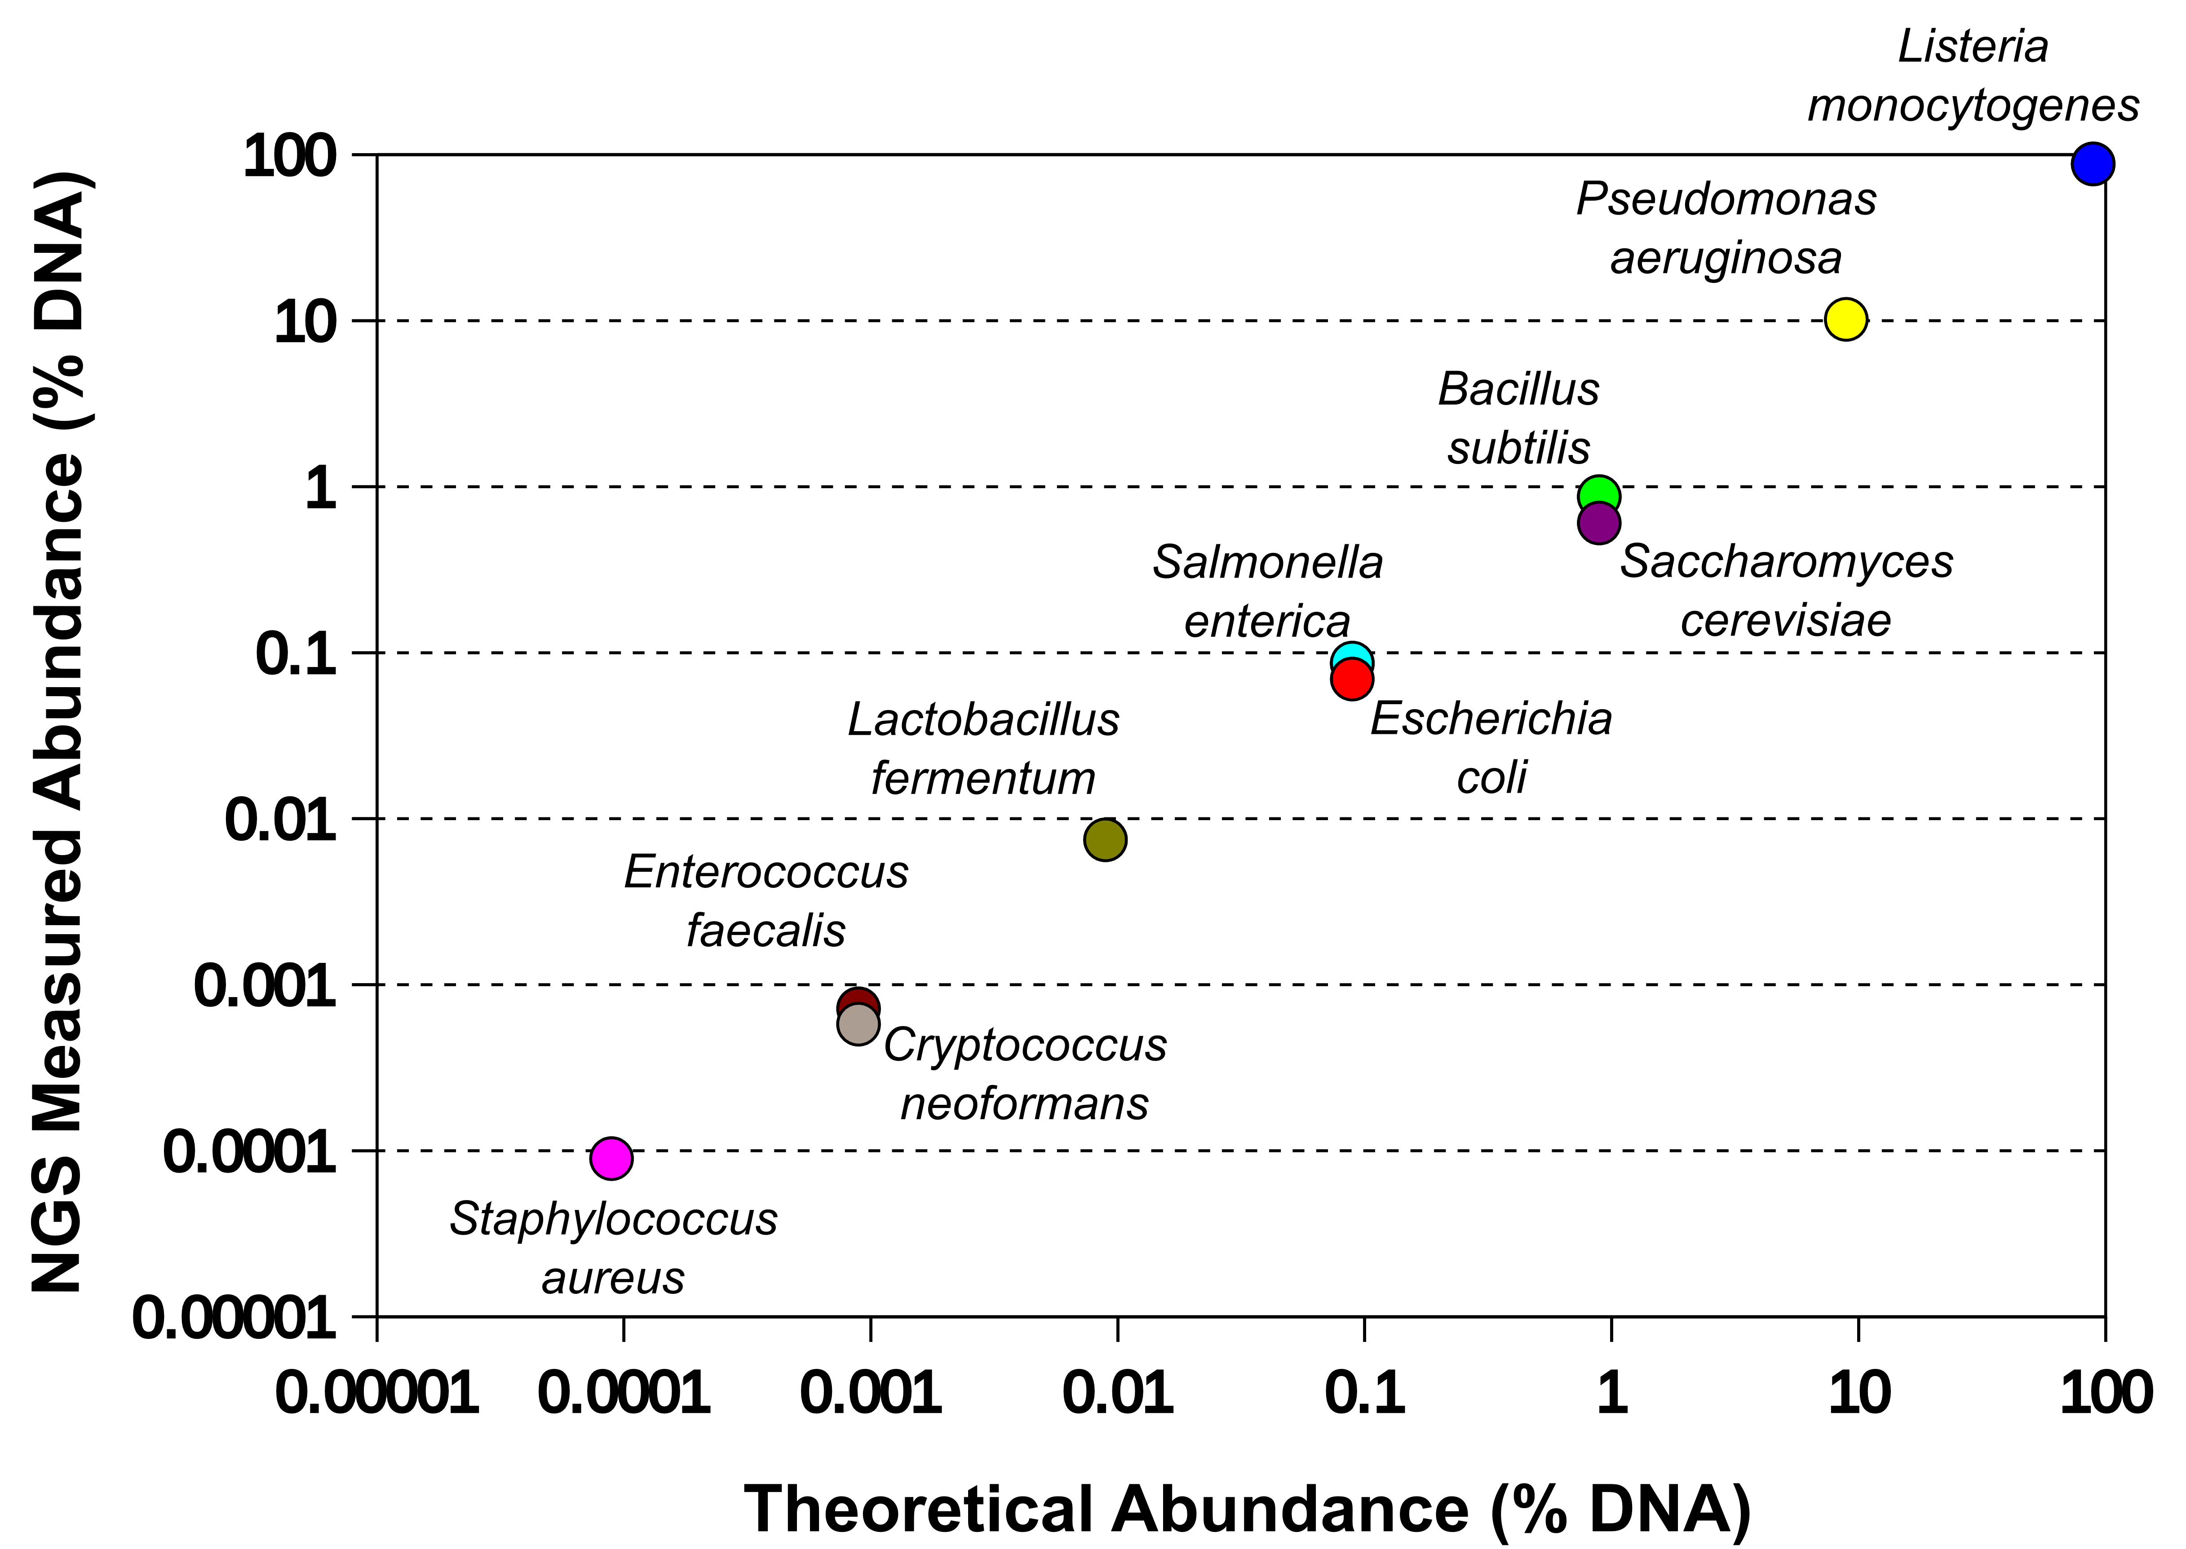
Microbiome Standards: Mock Microbial Communities
ZymoBIOMICS™ Microbial Community Standards
Even Abundance Standards
(D6300 and D6306)
Log-Distribution Standards
(D6310 and D6311)

Slide 12
What can Microbiome Standards tell us?

Slide 13
Yes! Microbiomics measurements can be very accurate!
Can we even make accurate microbiome measurements?

Slide 14
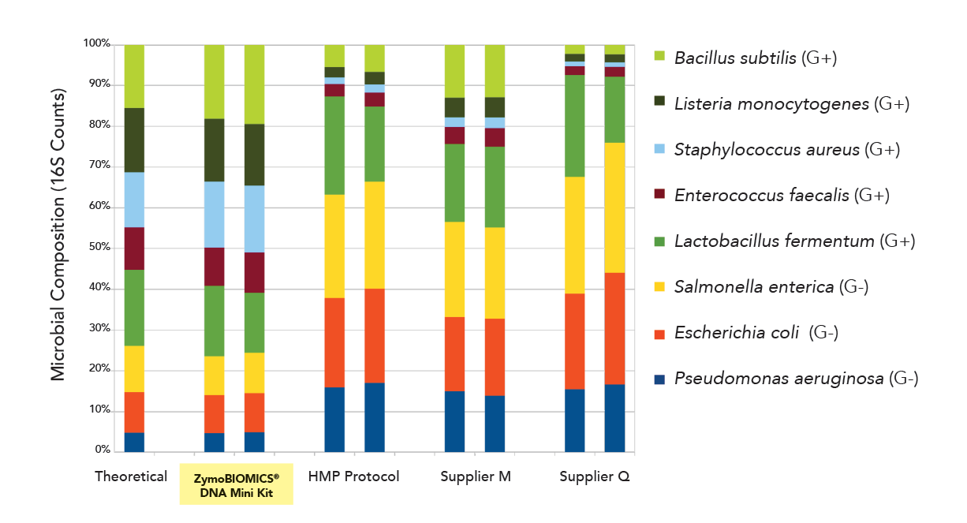
Are my microbiome measurements accurate?
Your Measurement

Slide 15
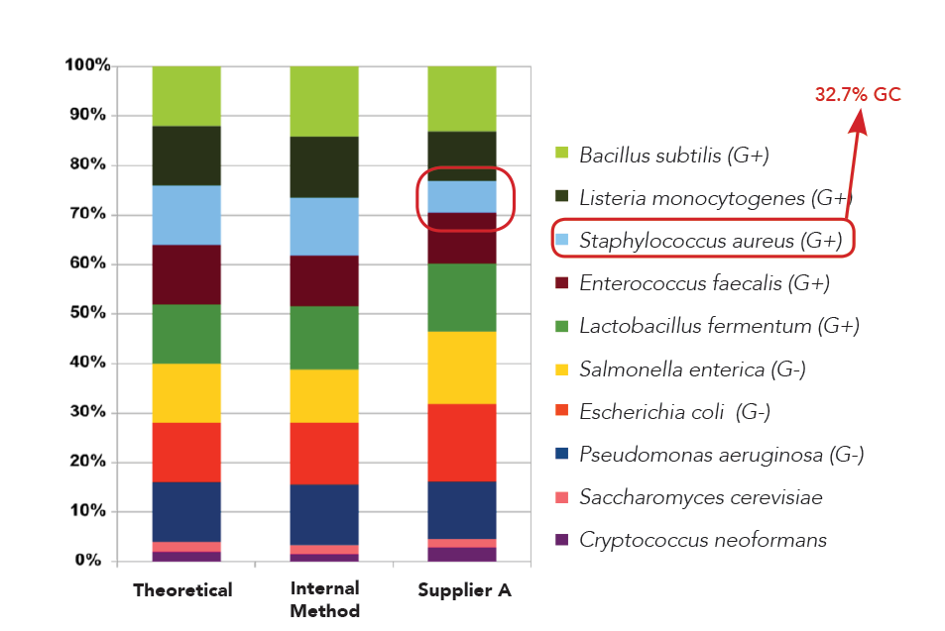
What causes the bias?
DNA Extraction?
Library prep?

Slide 16
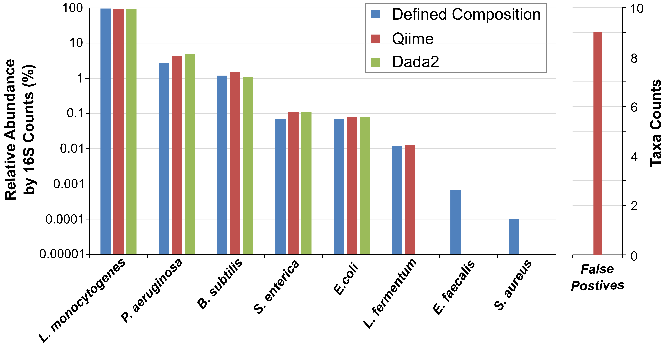
Where is my detection limit?
Log-Distribution Standards
(D6310 and D6311)

Slide 17
What makes a good microbiome standard?
A standard cannot mimic every sample type.
A standard should mimic major challenges in the workflow.
A standard should have an accurate defined composition.

Slide 18
Mimic Major Challenges in Microbiomics Workflows
Challenges | Our Design
Cell lysis bias caused by different cell wall toughness | G+ and G-
Cell lysis bias caused by different cell size | small bacterial cells and big fungal cells
Bias caused by GC content variation | A wide range of GC content
Across kingdom microbial identification | Kingdoms: Bacteria and Fungi
Accurate measurement of microbial abundance | Accurate microbial composition certified (<15% deviation)
False positives | Certified low bioburden (any foreign taxa >0.01% are false positives)
Accurate profiling across a wide range of abundance | Standard II has a log-distributed abundance
High sensitivity or low detection limit | Standard II tests detection limit
Detecting human pathogens | Contain 7 human pathogens
Virulence or antibiotics resistance gene profiling | Contain 7 human pathogens that carries different virulence and antibiotics resistance genes

Slide 19
Accurate Composition and Negligible Contaminations
Our certification:
<15% deviation from defined composition
<0.01% foreign microbial DNA
CofA from Supplier A:
< 1 log deviation from defined composition
< 10 % foreign microbial DNA
Even Abundance Standards
(D6300 and D6306)

Slide 20
Pitfalls in Microbiome Measurements

Slide 21
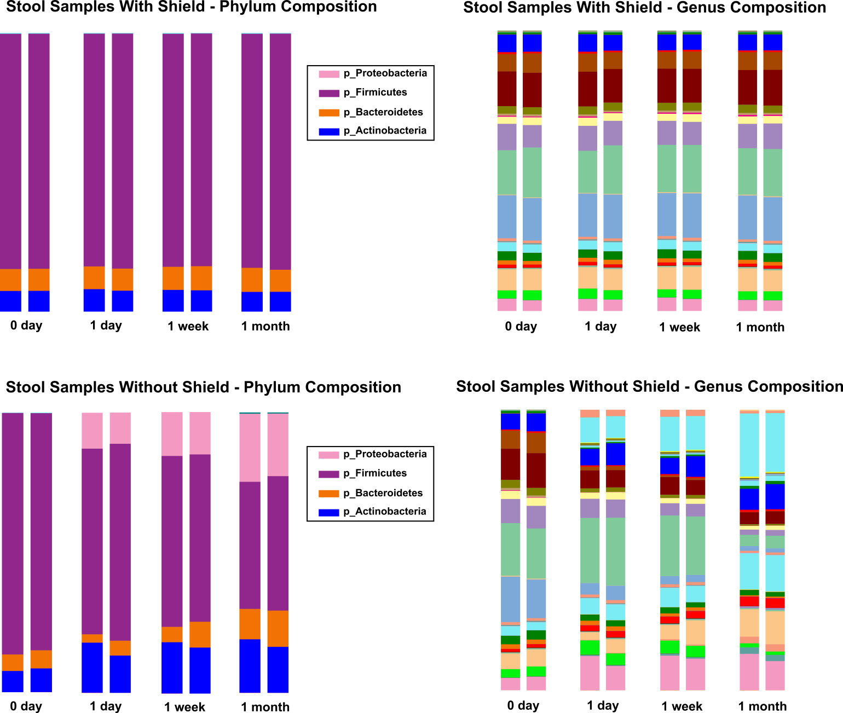
Pitfall 1: Microbiome profiles are stable before DNA extraction
Phylum
Genus
Stool samples stored at ambient temperature over 1 month

Slide 22
Cold-Free Microbiome Sample Preservation with DNA/RNA Shield™
Phylum
Genus
Preserve Microbiome Profiles at Ambient Temperature for > 1 Month

Slide 23
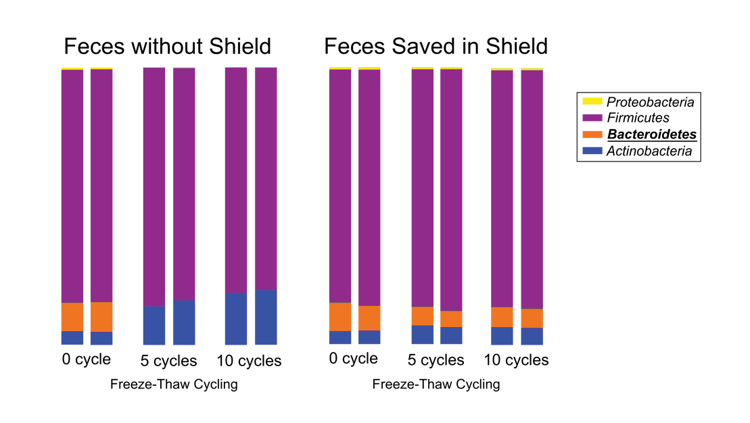
Pitfall 2: Frozen samples are always save!

Slide 24
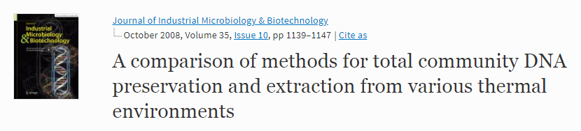

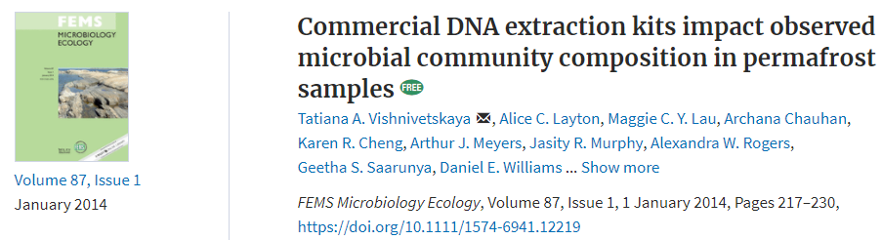

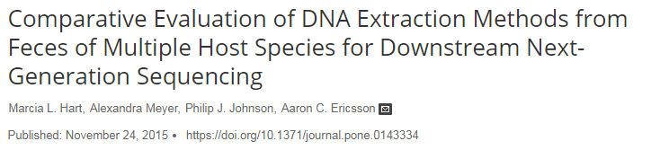
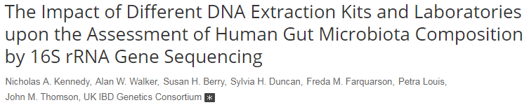
Pitfall 3: Common DNA extraction kits are OK.

Slide 25
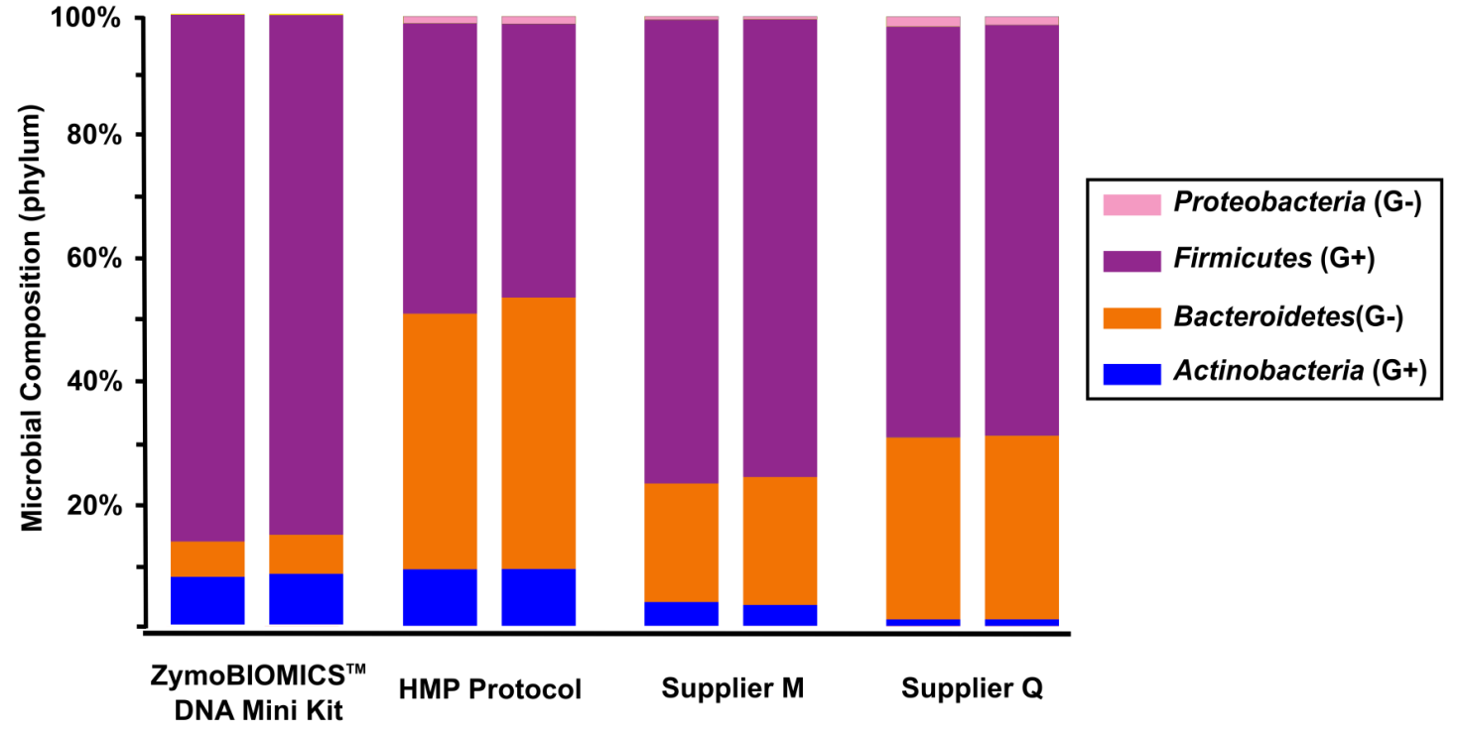
Huge Variations Caused by DNA Extraction Alone!

Slide 26
Benchmarking DNA Extraction Methods with
ZymoBIOMICS™ Microbial Community Standard

Slide 27
Now it makes sense!

Slide 28
Address Unsolved Challenges with New Tools

Slide 29
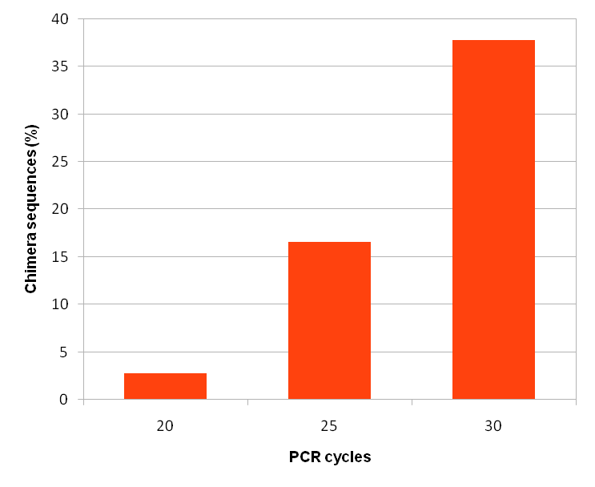
Artifacts in 16S Library Preparation
PCR chimera can be as high as >35%
Chimera increases with PCR cycles
Your primers might miss important targets.
DNA standard
+
Uchime
Common V3-V4 primers miss methanobrevibacter in the gut and Propionibacterium on the skin.
Common V1-V2 or V1-V3 primers miss Bifidobacterium, Chlamydia and Borrelia

Slide 30
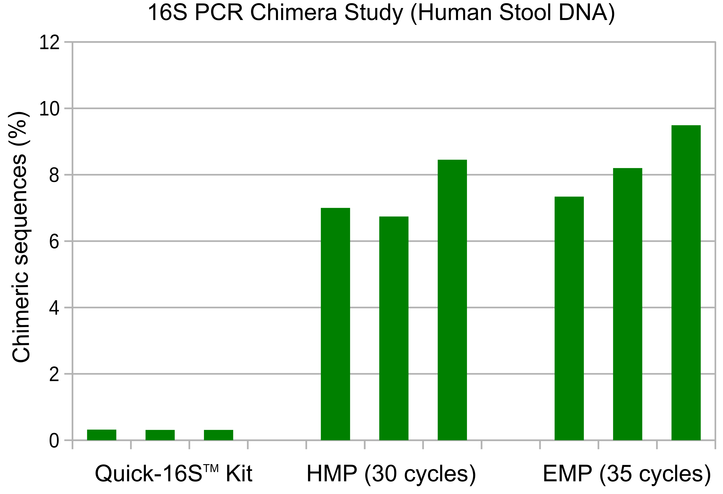
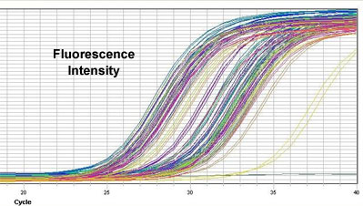
Quick-16S™ NGS Library Prep Kit
Reduce PCR Chimera
Real-Time PCR

Slide 31
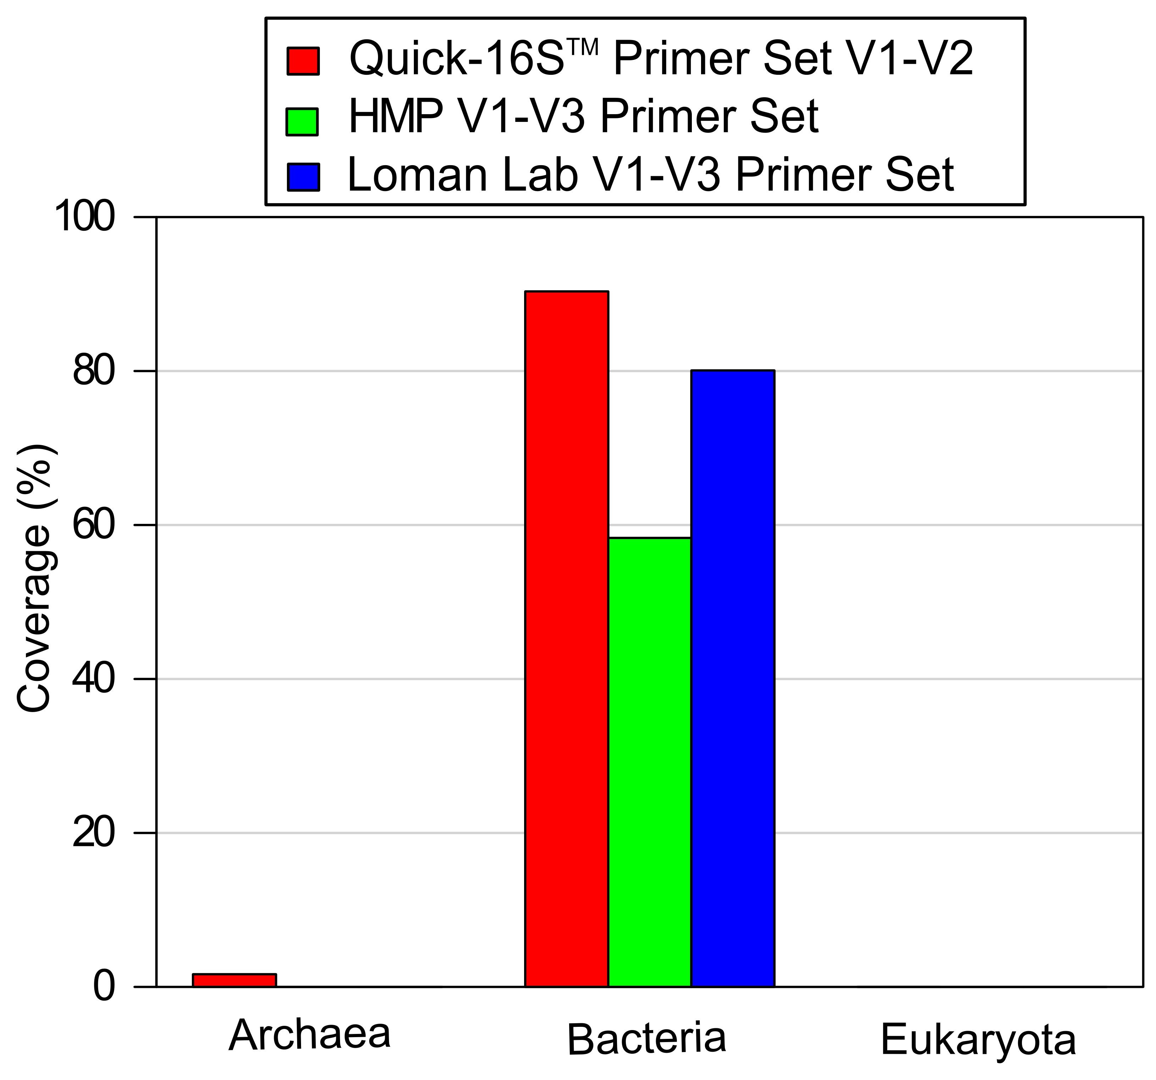
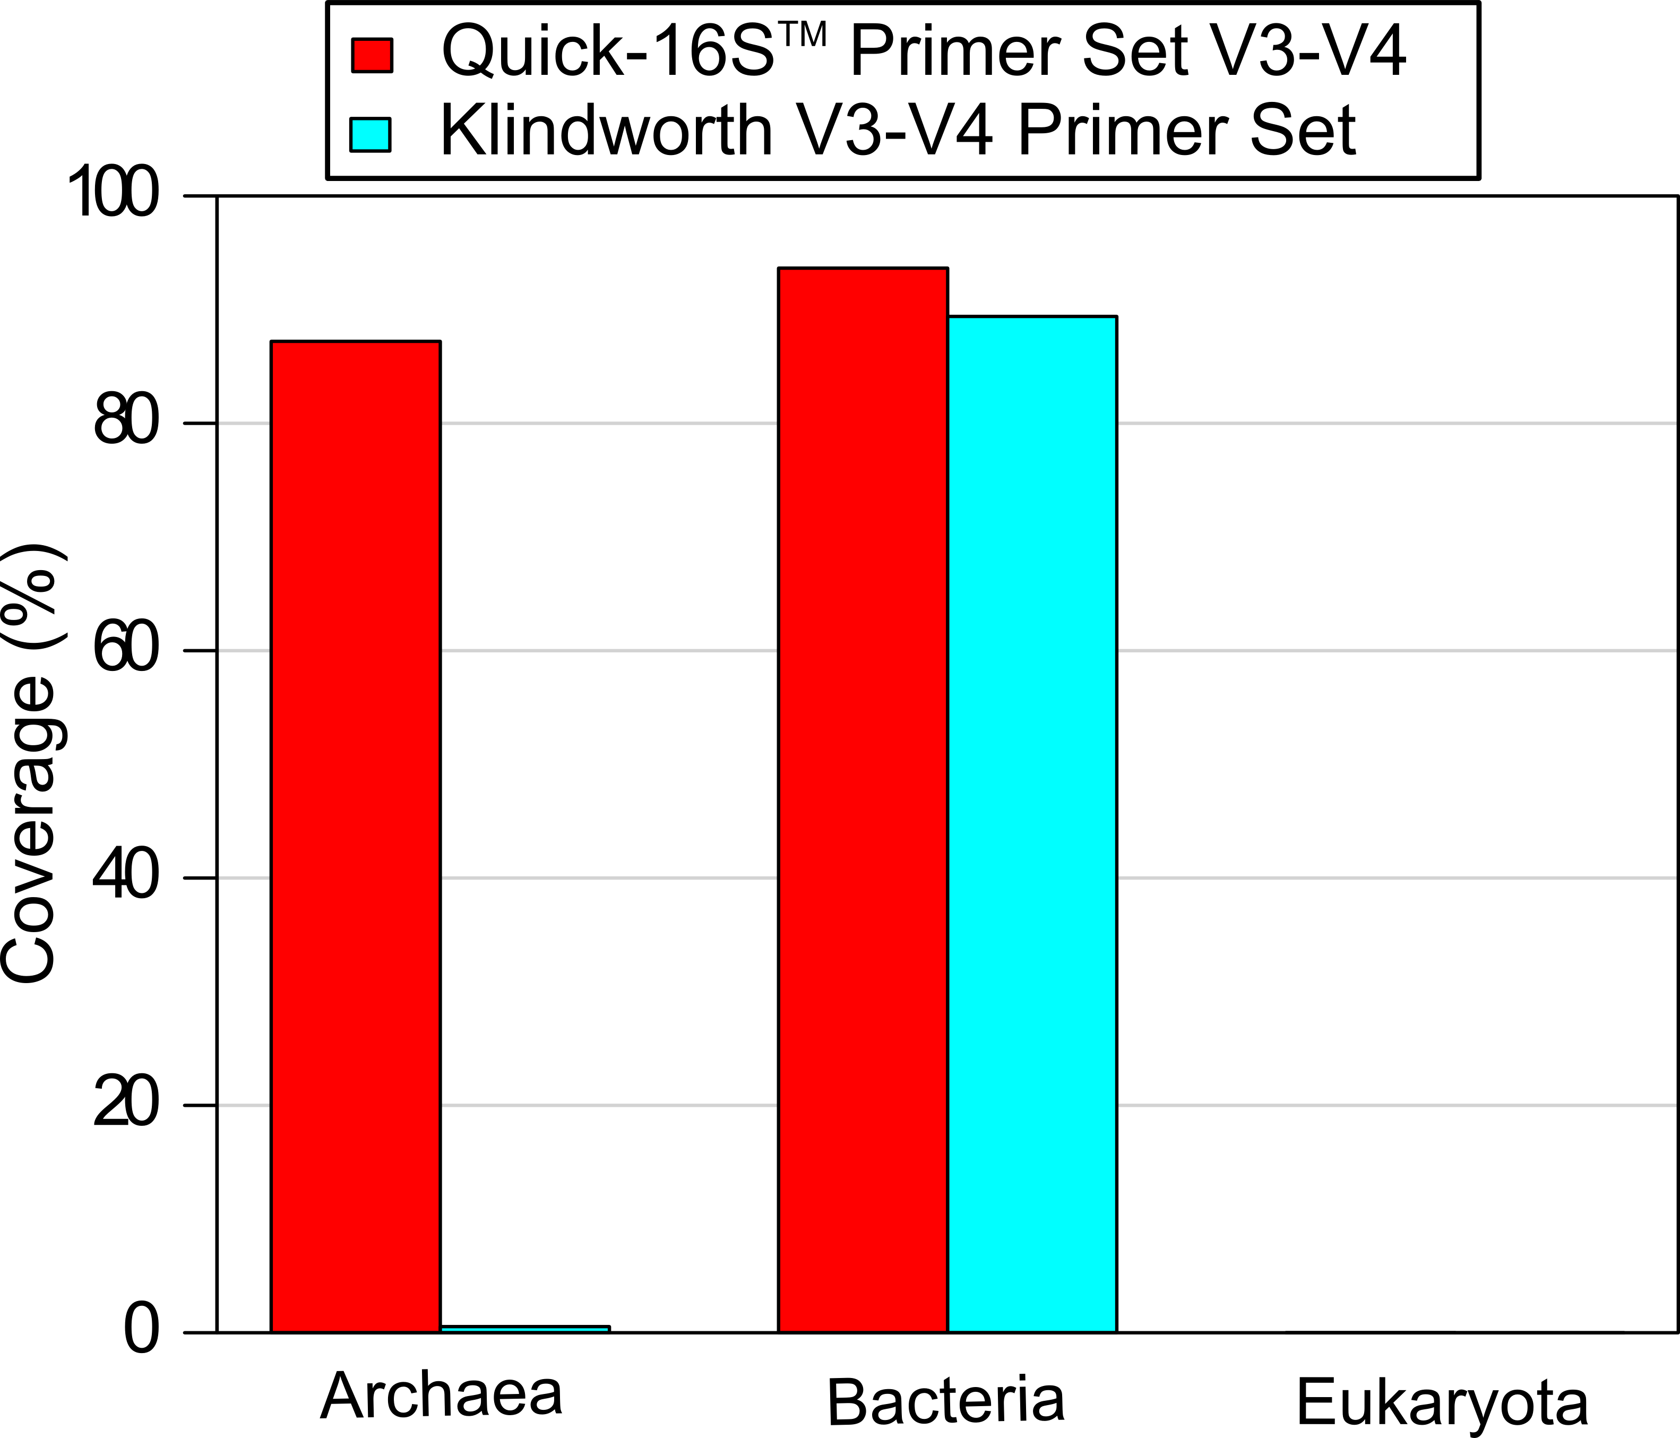
Quick-16S™ NGS Library Prep Kit
Improve Phylogenetic Coverage

Slide 32
Bring Absolute Quantification To Microbiome Measurements
For a microbial community, both percentage abundance and absolute abundance matter!
BioPool™ Spike-in Standards
Real time PCR??
Lots of additional work!
In situ Quality Control
Absolute Abundance Quantification

Slide 33
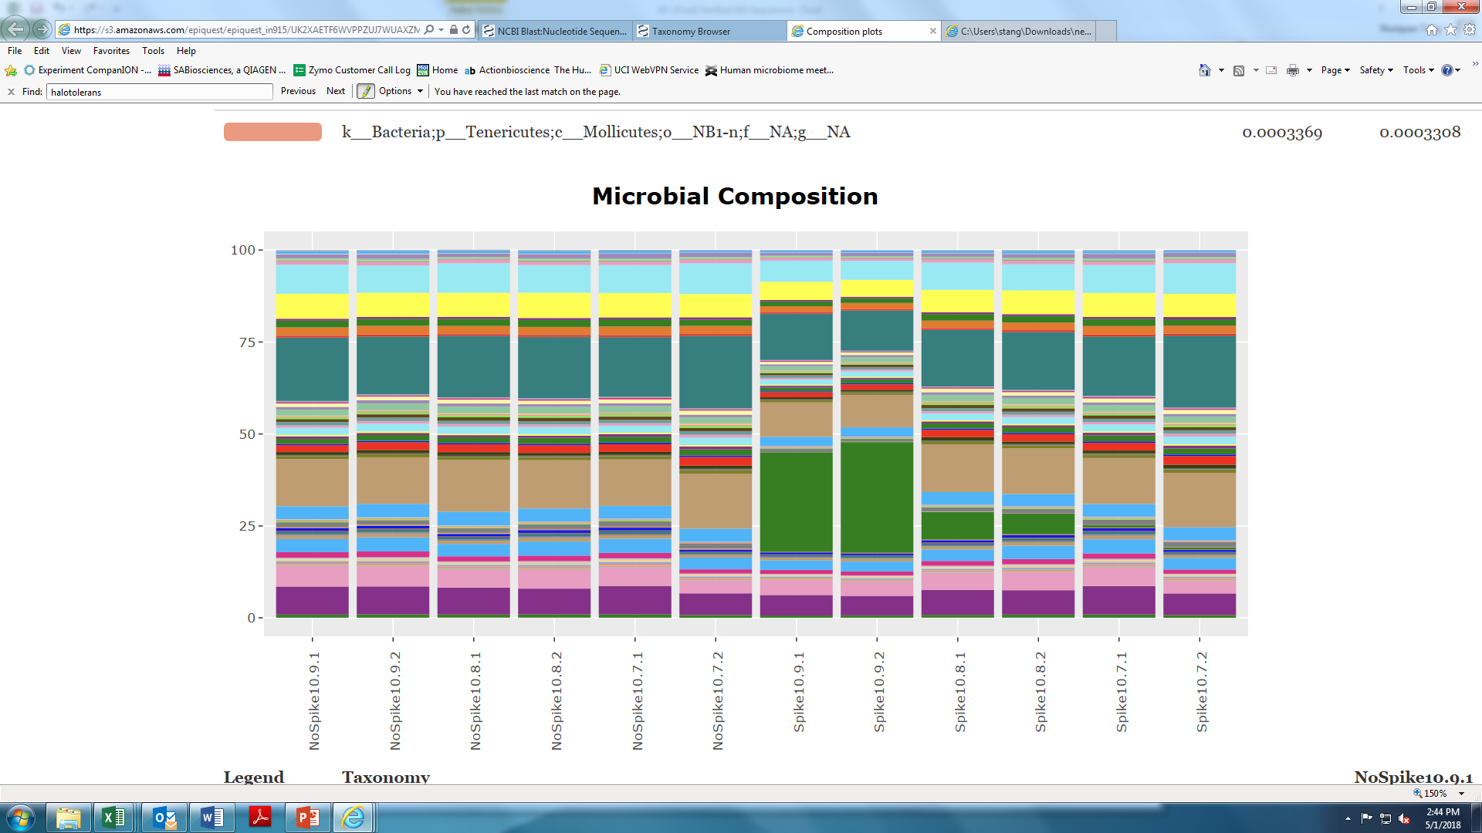
Case Study: how many microbial cells are there in 10 mg stool?
Add 10⁸ cells of BioPool™ Spike-in Standard into 10 mg stool and perform 16S sequencing.
Subtract the spike-in taxon
Imtechella halotolerans
With Spike-in Standard
(1x 10⁸ cells)
Control
With Spike-in Standard
(1x 10⁸ cells)
Control
~6% of reads belongs to I. halotolerans (10⁸)
~ 1.54x10⁹ cells are present in 10mg stool.

Slide 34
Species-Level Resolution with Regular 16S Sequencing
Is it Possible?

Slide 35
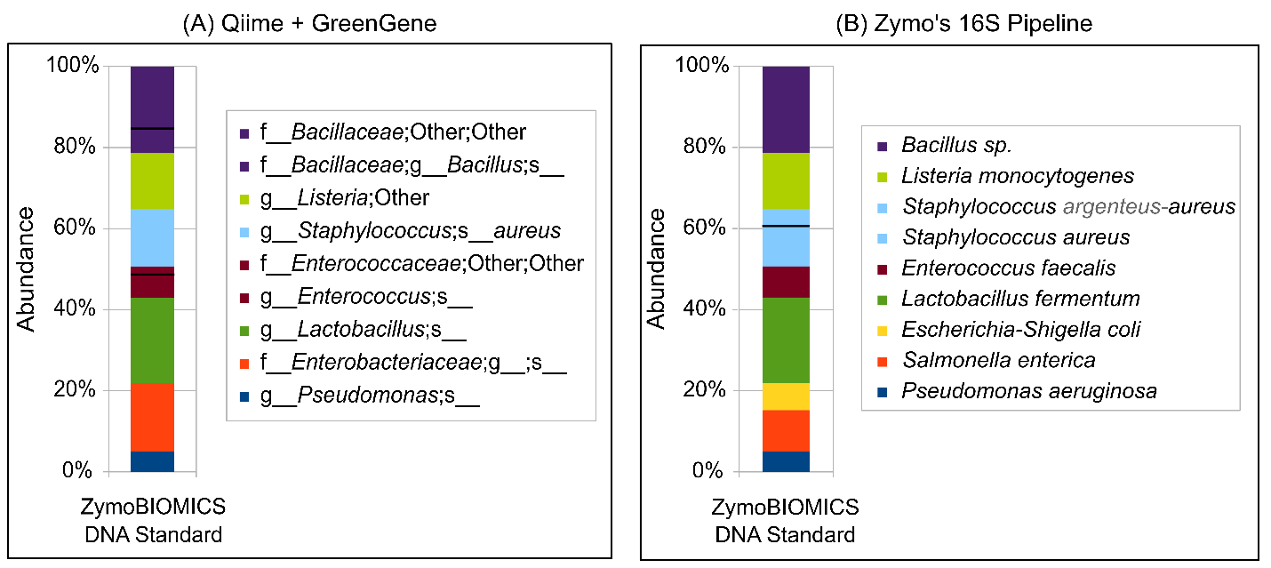
Yes, if done in the right way!
Library prep with Quick-16S™ kit using 16S V1-V2 primers; Illumina MiSeq 2x300bp.

Slide 36
A Mock Community of 20 Common Gut Microbes
# | Phylum | Species | Zymo Research | QIIME + GreenGenes |  | # | Phylum | Species | Zymo Research | QIIME + GreenGenes
1 | Euryarchaeota | Methanobrevibacter smithii | √ | x |  | 11 | Firmicutes | Dialister invisus | √ | x
2 | Actinobacteria | Bifidobacterium adolescentis | √ | √ |  | 12 | Firmicutes | Eubacterium rectale | √ | x
3 | Actinobacteria | Bifidobacterium angulatum | √ | x |  | 13 | Firmicutes | Lactobacillus fermentum | √ | x
4 | Actinobacteria | Bifidobacterium ruminantium | √ | x |  | 14 | Fusobacteria | Fusobacterium nucleatum | √ | x
5 | Actinobacteria | Collinsella aerofaciens | √ | √ |  | 15 | Lentisphaerae | Victivallis vadensis | √ | x
6 | Bacteroidetes | Bacteroides fragilis | √ | √ |  | 16 | Proteobacterium | Bilophila wadsworthia | √ | x
7 | Bacteroidetes | Prevotella copri | √ | √ |  | 17 | Proteobacterium | Escherichia coli | √ | x
8 | Bacteroidetes | Sphingobacteriaceae sp. | √ | x |  | 18 | Proteobacterium | Sutterella wadsworthensis | √ | x
9 | Firmicutes | Catenibacterium mitsuokai | √ | x |  | 19 | Synergistetes | Pyramidobacter piscolens | √ | √
10 | Firmicutes | Clostridium difficile | √ | x |  | 20 | Verrucomicrobia | Akkermansia muciniphila | √ | √
Species Identification: Zymo (20/20), QIIME + GreenGenes (6/20).
Library prep with Quick-16S kit using 16S V3-V4 primers; Illumina MiSeq 2x300bp.

Slide 37
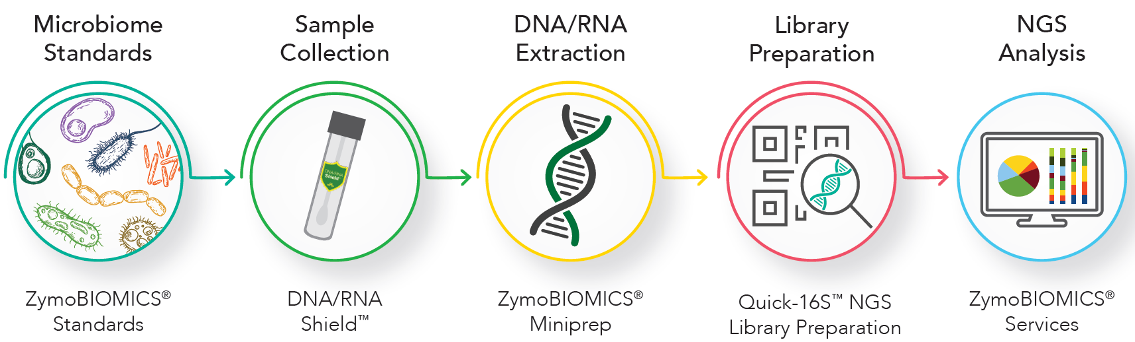
Zymo Research Microbiomics Portfolio
The Complete Microbiomics Solution
Kits
Accurate & Reliable
Cold-Free
Preservation
Unbiased
Extraction
Quick & Simple
Species-Level
Resolution

Slide 39
The Key to Species Level Resolution
16S amplification regions: V1-V2, V1-V3, V3-V4
Read error correction with Dada2
Taxonomy prediction algorithm
Well-curated reference databases

Slide 40
Shotgun Metagenomics Challenges
Incomplete database
High false positive rate
Host DNA prevalence

Slide 41
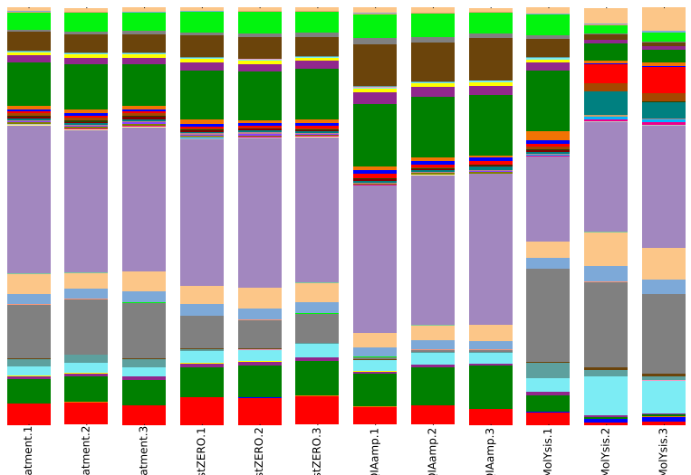
HostZERO™ Microbial DNA Kit
Deplete the most host DNA
Keep the most Bacterial DNA
Preserve the best Microbiome Profile
Haemophilus (Gram -)
Streptococcus (Gram +)
Prevotella (Gram -)
Rothia (Gram +)
No Treatment
HostZERO
Supplier Q
Supplier M
No Treatment
HostZERO
Supplier Q
Supplier M
No Treatment
HostZERO
Supplier Q
Supplier M

Slide 42
Pitfall 4: All mechanical lysis methods are the same.
Bead size and material matters!
Small beads lyse small cells, big beads lyse big cells.
Not all bead beaters work!
Linear motion never works; prefer figure-8 or other chaotic motion
Optimum bead beating conditions varies from machine to machine.
Precellys-24, 3 min; Fastprep-24, 5 min; Disruptor Genie, 20-30 min.
The performance of some equipment can deteriorate over time.

